Slide 1

Trip Buddy
1
Adithya Narayanan, Brian Avner, Kyle Griffin, Lucas Drager, Nasir Naqiv, and Phillip Kononenko

Slide 2


The Pitch
2
Trip Buddy is a platform that brings together people who love getting out into the world, and who would like to join some fellow adventurers along the way!
Whether it be protecting the environment, saving on gas, or just some good company, Trip Buddy offers a painless, centralized, and social forum for trip coordination. All of this with the flexibility to plan trips how you want to take them.
Unlike platforms like Uber, Trib Buddy does not have a built in pricing structure, and does not take a cut from drivers. This gives users the freedom to decide what is personally worth it, and ultimately spend less money due to the lack of overhead fees. It also allows for friends to use Trip Buddy as a free organizational tool!
Trip Buddy
(FREE)

Slide 3

Project Description
3
Project Goals
Securely keep track of all user data with authentication middleware and ensure user sessions display relevant, authorized information
Allow users to post trips and join other users trips
Allow trip owners to edit details of trips once created
Allow users to directly pay another user for trips (gas money, wear & tear, etc.)
Facilitate chat rooms where users can message one-another regarding trip details
Maintain user profiles and provide flexible customization options

Slide 4
Tools used
4
Project Tracker (GitHub projects) | ★★★★ | Application Server (NodeJS) | ★★★★★
VCS repository (GitHub) | ★★★★★ | Deployment environment (LocalHost, Browser though Azure) | ★★★★
Database (PostgreSQL) | ★★★★★ | External APIs (Google Maps) | ★★★
IDE (VSCode) | ★★★ | Testing tool (Chia and Mocha) | ★★★
UI Tools (Wireframing tools, HTML, EJS, JS) | ★★★★★ | Framework (Node.js) | ★★★★

Slide 5
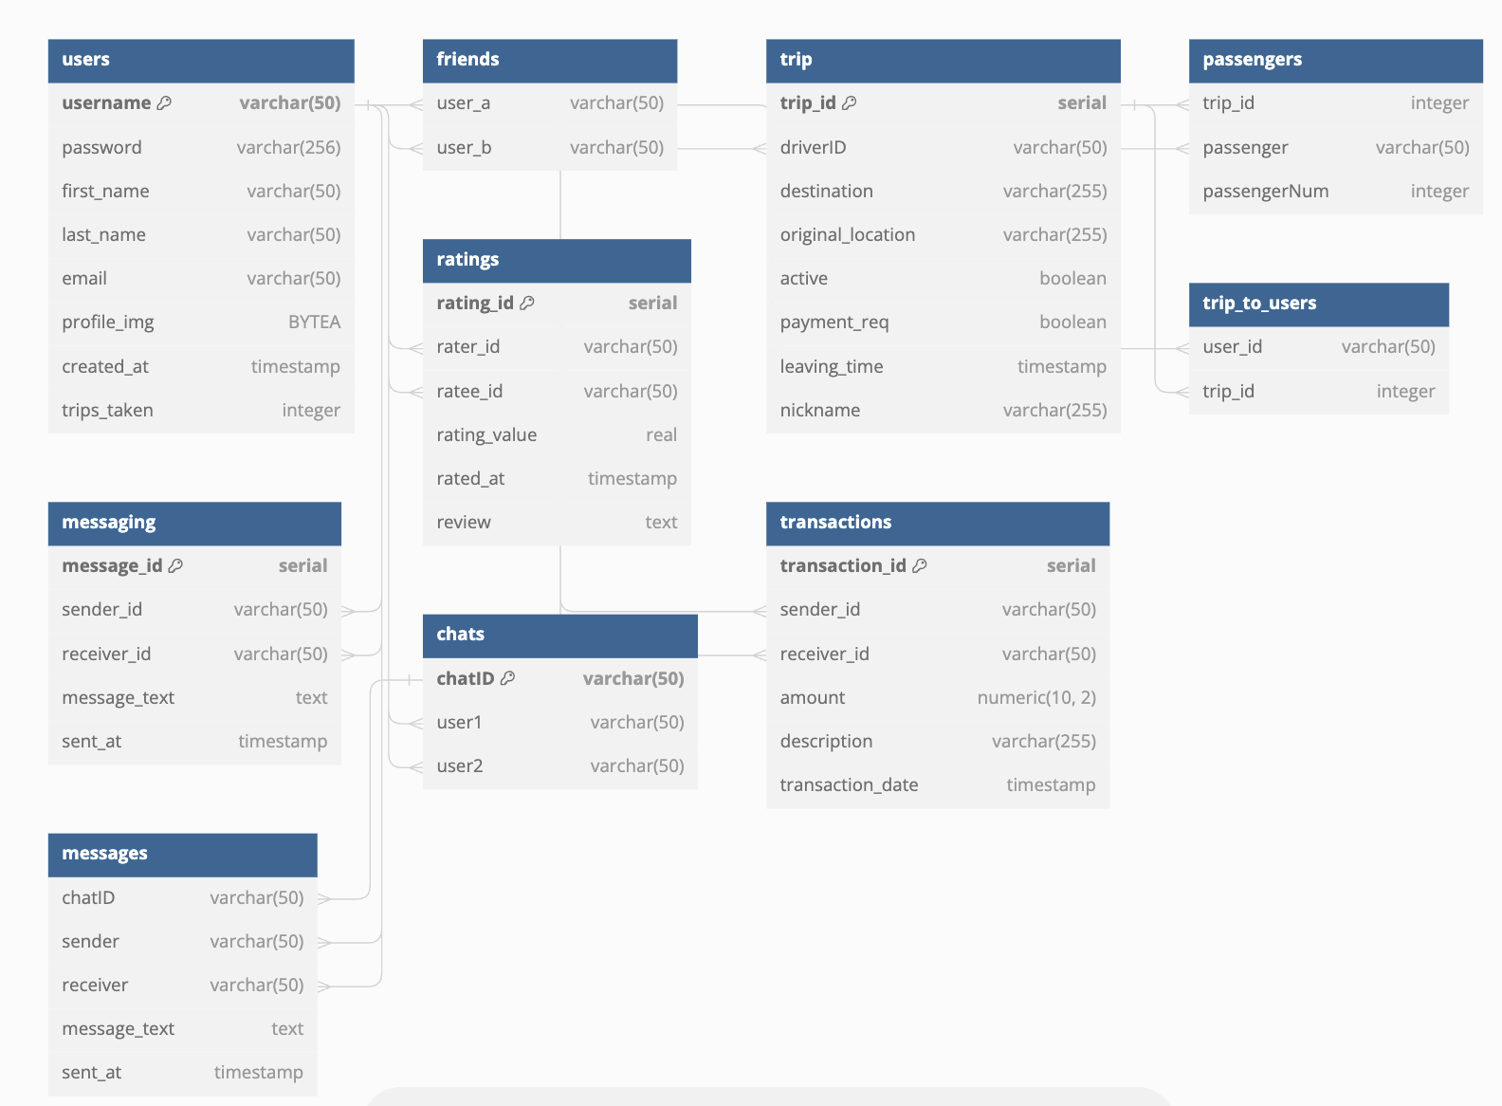
ERD Diagram
5
Primary Keys:
Username (users)
Trip_id (trip)
Message_id (messaging)
Rating_id (ratings)
Transaction_id (transactions)

Slide 6
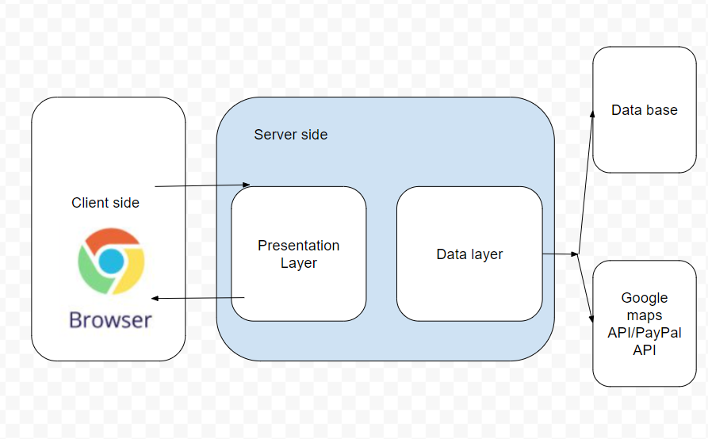
Architecture Diagram

Slide 7

Trials and Tribulations
6
We’ve had our share
Some of our most common issues were:
Merge Conflicts
Database Issues (Internal Server Errors)
Retrofitting Old Architecture
And the Bugs…

Slide 8

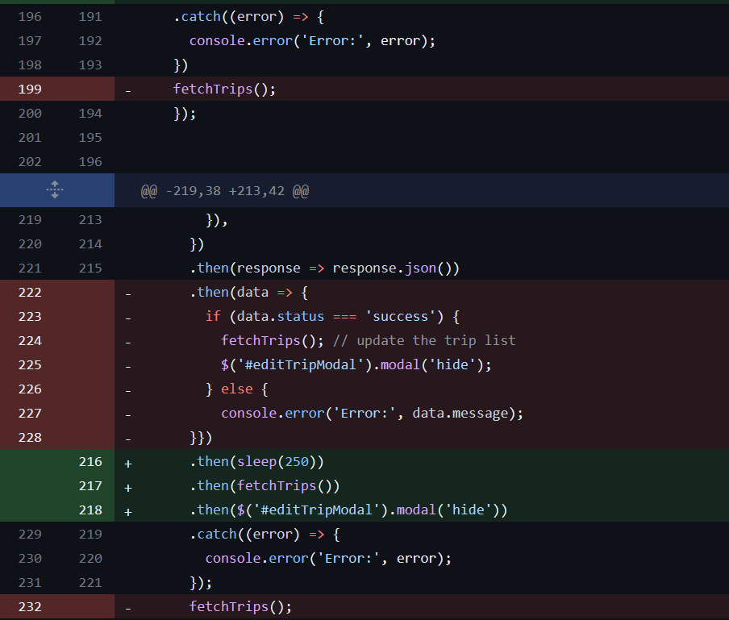
Memorable Bugs
Rather funny…. In retrospect
7
The Curse of 3
The Possessed Submit Button
Can’t overwrite response object
Psycho Phillip (11pm apis not working but a simple solution)

Slide 9
Project Demo
8
http://recitation-013-team-05.eastus.cloudapp.azure.com:3000
Note: Can access on mobile but site was designed for web.

Slide 10
What else we would have like to accomplish
9
Adding automatic payment calculator
Payment before scheduled departure time
Limit to number of seats
Password protected user deletion
Weather API
Google Maps API integration to track number of miles each user has travelled
Trip search functionality
Trips by location

